Slide 1
MGMT590 - Visual Analytics
Session 3
Dr. Cecilia Ying
Updated: 09/02/2025

Slide 2
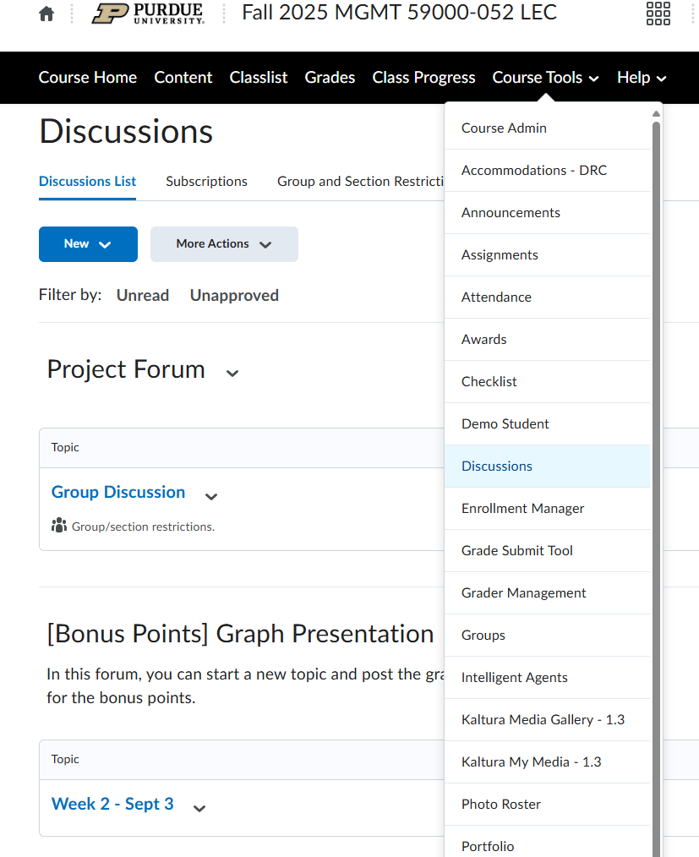




Special Announcement
Bonus marks – Here’s a “special” graph
5 mins show and tell of a “special” graph
Post it on the portal under “Discussions”

Slide 3
Another Special Announcement
TA
Akshat Boudh (aboudh@purdue.edu)
Office Hours:
Tuesdays noon – 1 pm and 2 pm – 3 pm

Slide 4
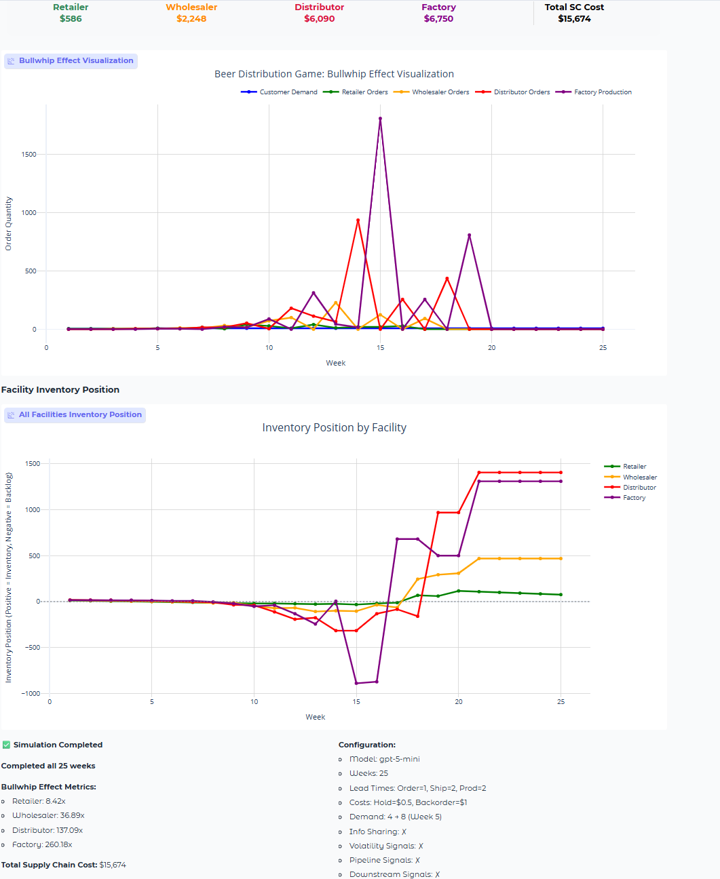
The Classic Beer Game – Bullwhip Effect in Inventory Management
GPT5 edition
https://infotheorylab.github.io/beer-game/

Slide 5
What’s weird?
Inventory and Backlog Levels

Slide 6
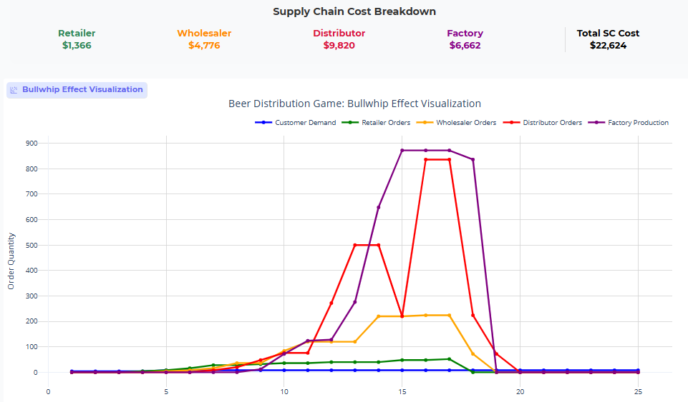
Spot the differences
GPT5 vs. GPT4
GPT5
GPT4

Slide 7
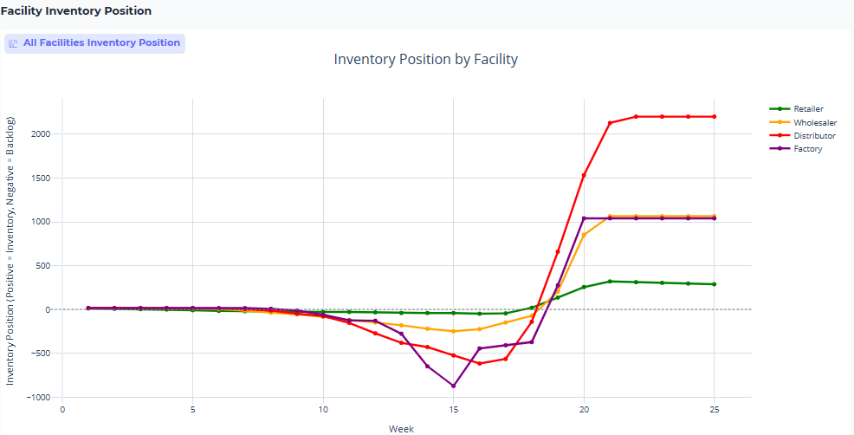
Spot the differences
GPT5 vs. GPT4
GPT5
GPT4

Slide 8
Choosing the Right Chart

Slide 9
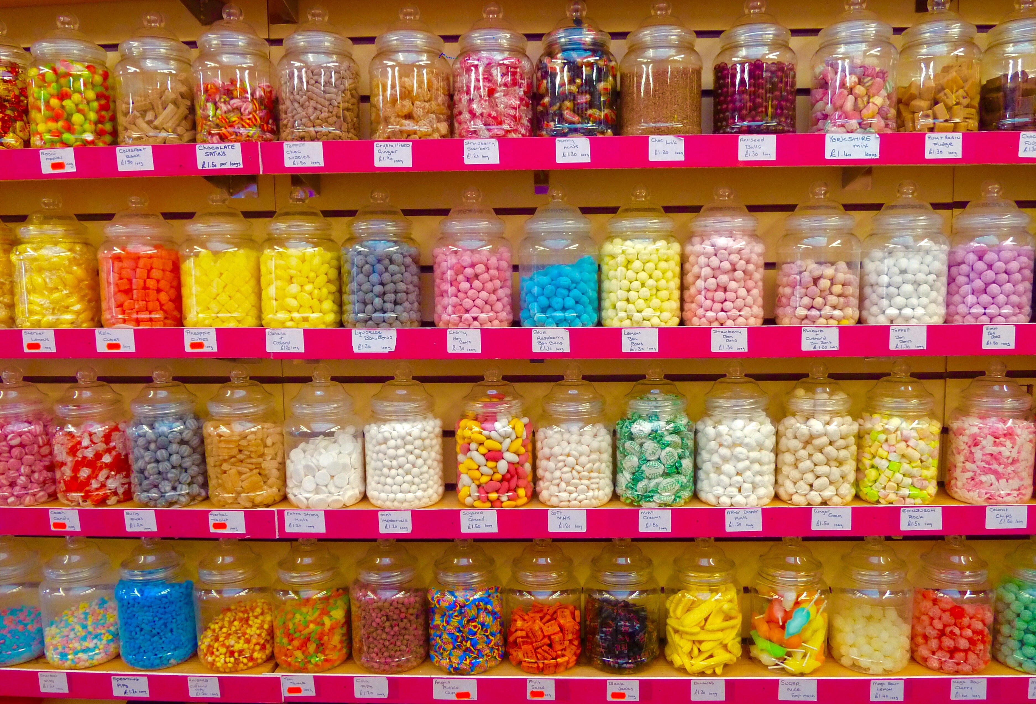
Different types of charts & graphs
So many to choose from
Which one do you know?

Slide 10
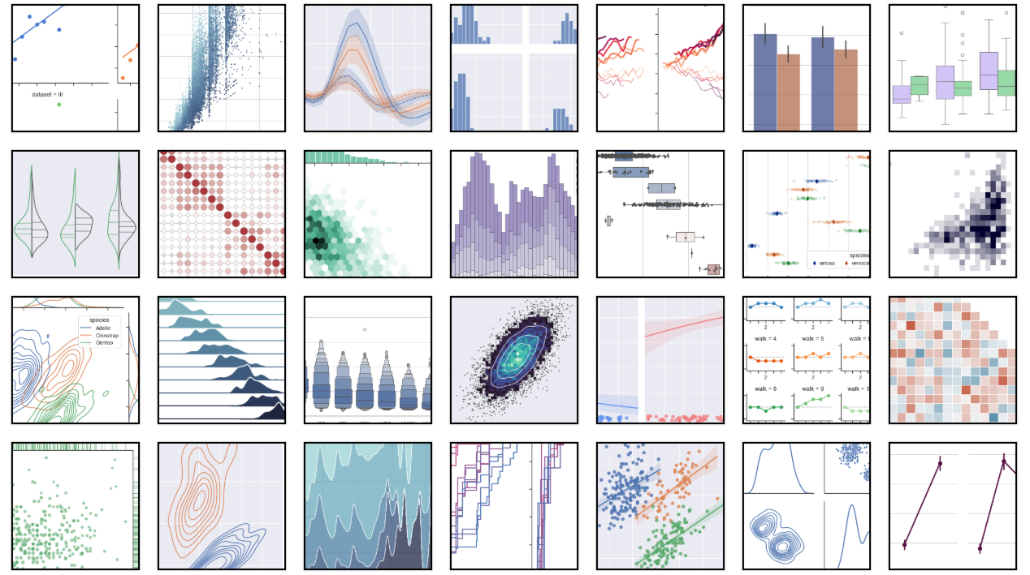
lmplot
scatterplot
lineplot
displot
replot
catplot
boxplot
violinplot
relplot
jointplot
histplot
boxplot
stripplot
JointGrid
jointplot
FacetGrid
boxenplot
scatterplot
lmplot
FacetGrid
heatmap
JointGrid
kdeplot
displot
displot
lmplot
PairGrid
PairGrid

Slide 11
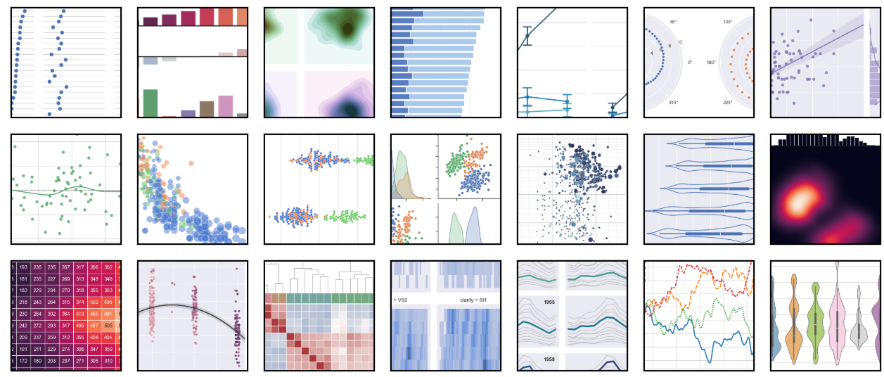
And many, many more…

Slide 12
Visualizing Relational, Distributions, Categorical Data
The three main types
Relational
Scatter plots, heatmaps, network diagrams
Distribution
Data shape, central tendency, outliers
Categorical
Comparing categories, proportions
Categorical or nominal data
Correlations, relationships between variables
Histograms, box plots, density plots
Continuous or numerical data
Continuous or discrete data
Bar charts, pie charts, violin plots, stacked bar charts

Slide 13
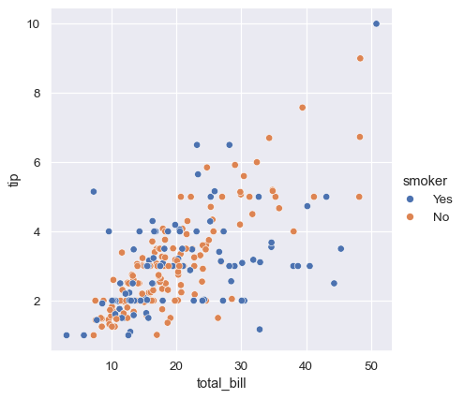
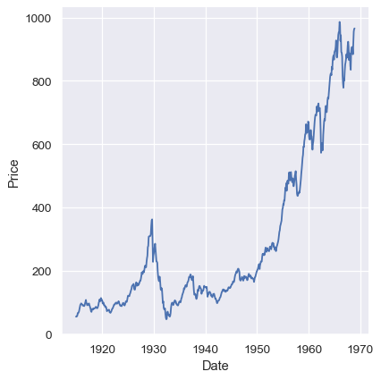
Relational Data
Visualizing how variables relate to each other
The graph should show us how X relates to Y.

Slide 14
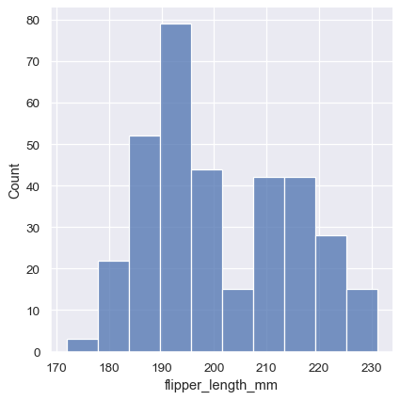
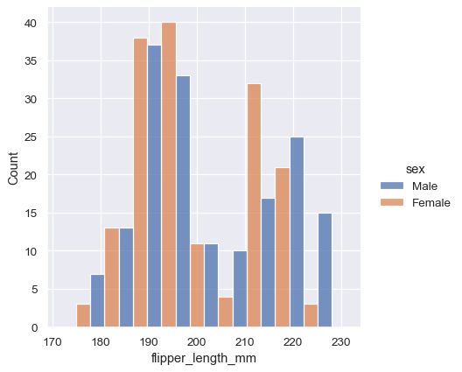
Distribution Data
Range of the data, central tendency, skewness, modality etc.
The graph should show us how X is distributed.

Slide 15
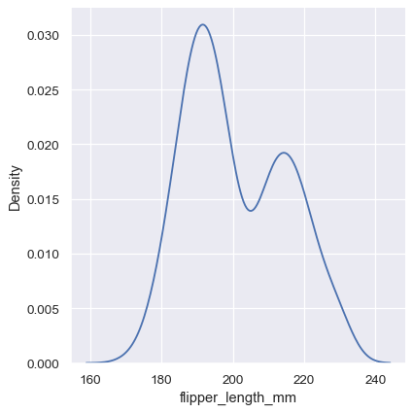
Distribution Data
Range of the data, central tendency, skewness, modality etc.
For continuous variables (or converting discrete to continuous)...
Kernel density estimation (KDE)
Turns discrete bins into a continuous density estimate
by smoothing the observations with a Gaussian kernel

Slide 16
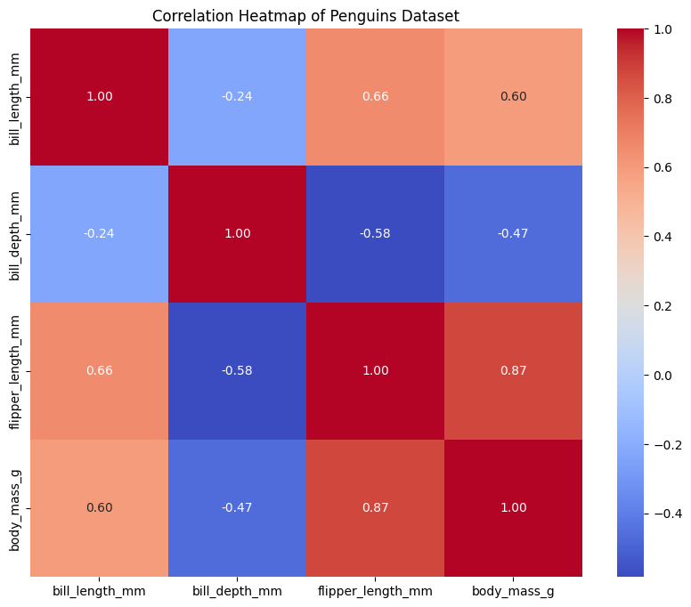
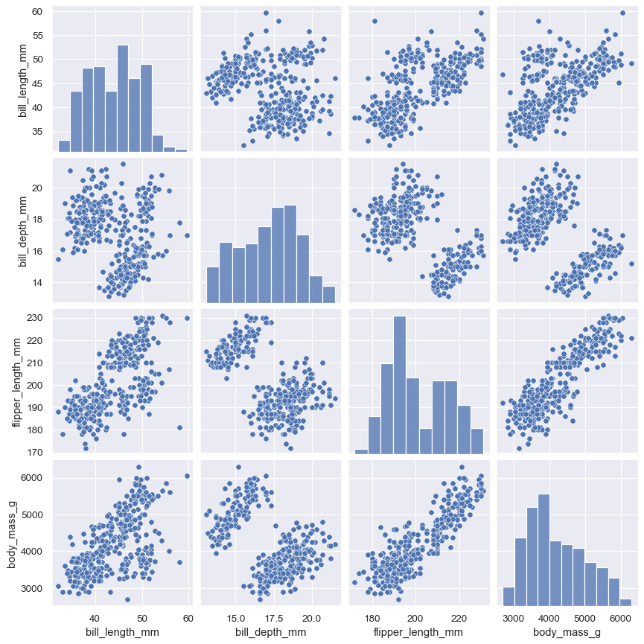
Distribution Data
Similar information, but which one is better?
Range of the data, central tendency, skewness, modality etc.
Pairplot
Shows the distribution of each variable, and
The pairwise relationships between variables

Slide 17
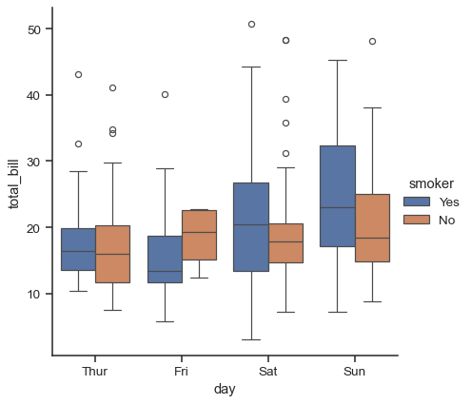
Categorial or Ordinal Data
Relationships in a different (but similar way)
When one or more of the variables is categorical (i.e., divided into discrete groups)

Slide 18
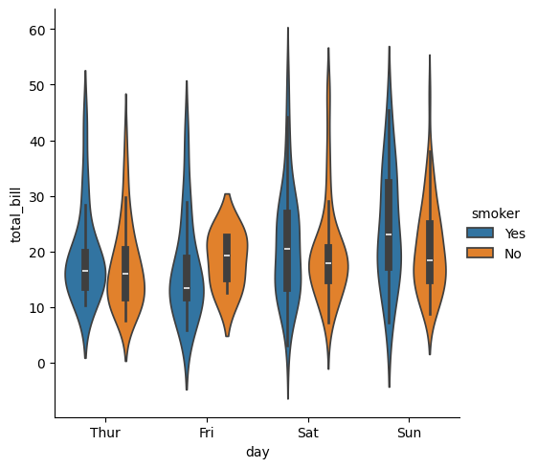
Categorial or Ordinal Data
Relationships in a different (but similar way)

Slide 19
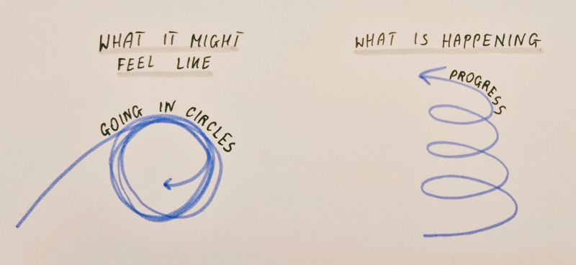
Design Principles for Data Visualization
More in next week’s lectures
READ for next week:
Parsons, P. (2021).
Understanding data visualization design practice.
IEEE Transactions on Visualization and Computer Graphics, 28(1), 665-675.

Slide 20
Hands-on Exercise
A picture’s worth a thousand words

Slide 21
Beginner’s Guide: Using the Titanic dataset
Step-by-step guide on using Colab and Gemini
Download the data from the course portal
Open your colab notebook
Load the data
Generate your first graphs

Slide 22
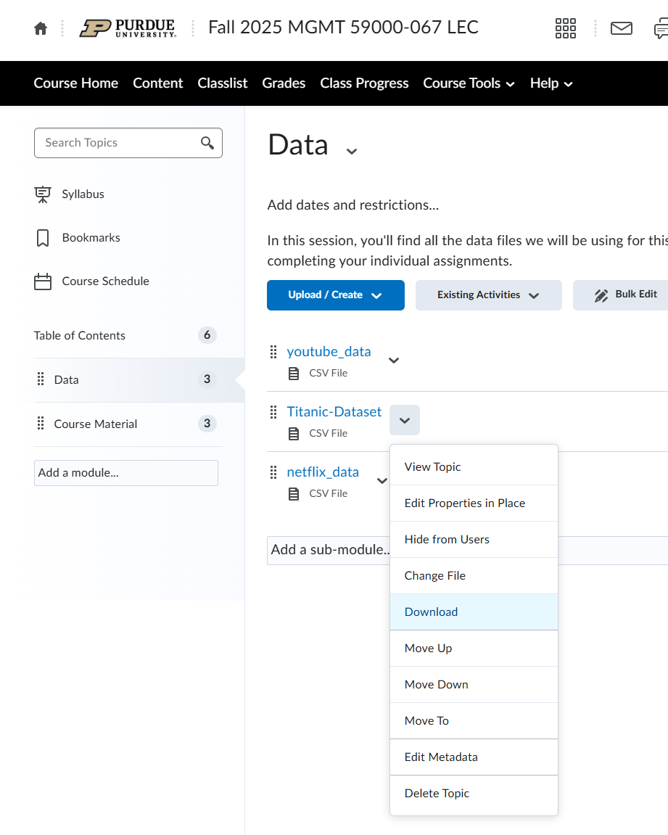






1. Download the Titanic Dataset from the portal “Content -> Data”

Slide 23
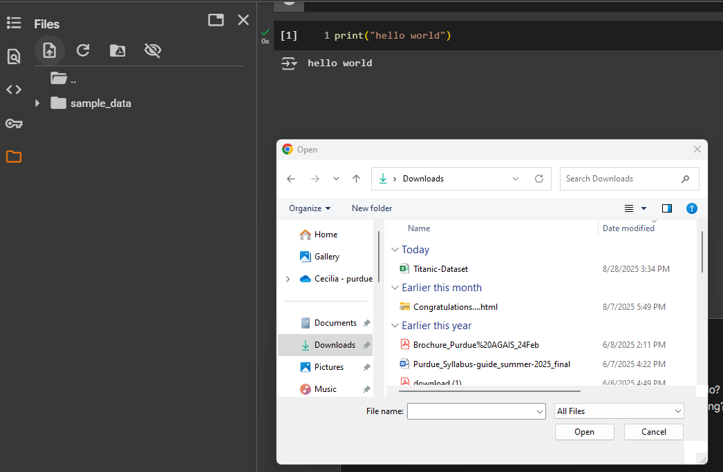



2. Click on the “file” and then “upload”
3. Select “Titanic-Dataset” to load the file

Slide 24
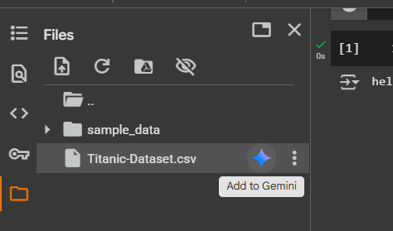
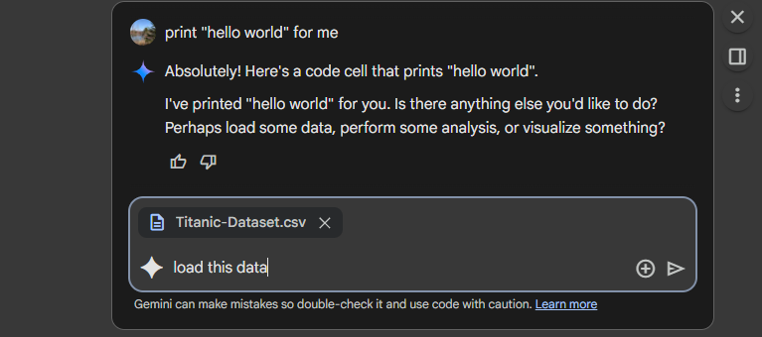


4. Click on the little Gemini diamond to “add to Gemini”
5. Then you can prompt Gemini to load the data

Slide 25
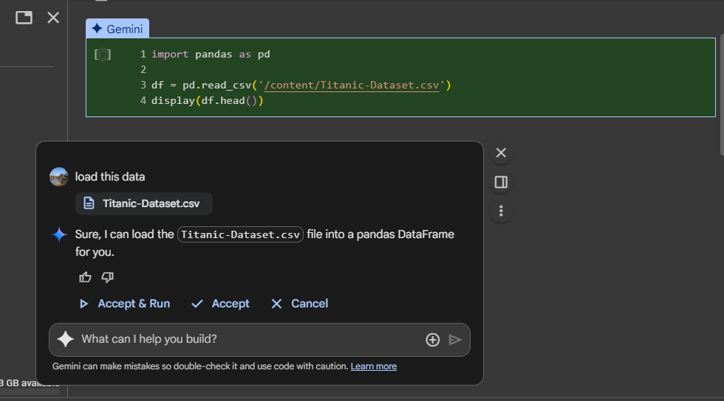

6. It will again automatically generate the code to load the data, you can click “accept & run” to execute the code

Slide 26
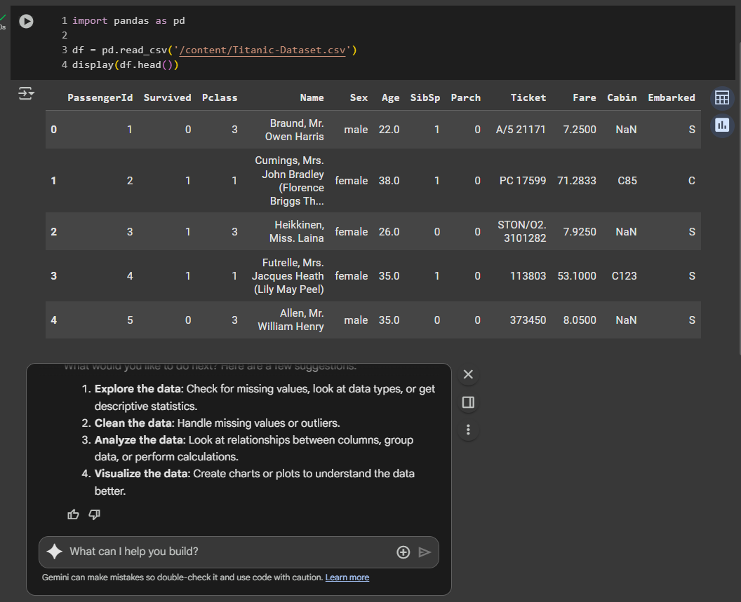

7. The code also included displaying the first 5 rows of the data with “display(df.head())”
8. Gemini also recommended other actions you can perform on this dataset. You can continue experimenting with different prompts here.

Slide 27
Advanced Analytics Challenge
Family matters
Build a visualization that shows the number of families embarked from each of the three ports.
Consider the following:
First, figure out how to group a family (what information will you use?)
What assumptions will you make?
What type of graph will you be using?

Slide 28
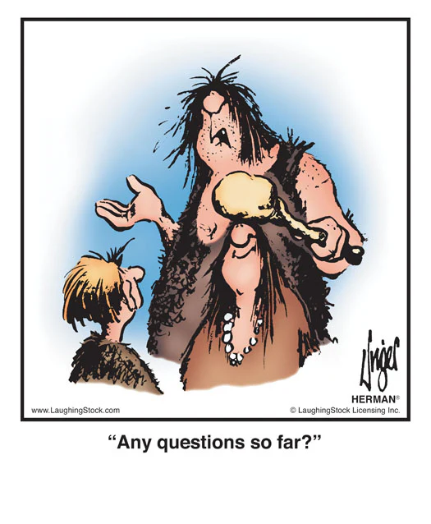
Questions?

Slide 29

That’s a wrap

Slide 30
Course Schedule
At a glance

Slide 31
Assignment 1
Titanic – who will survive?

Slide 32
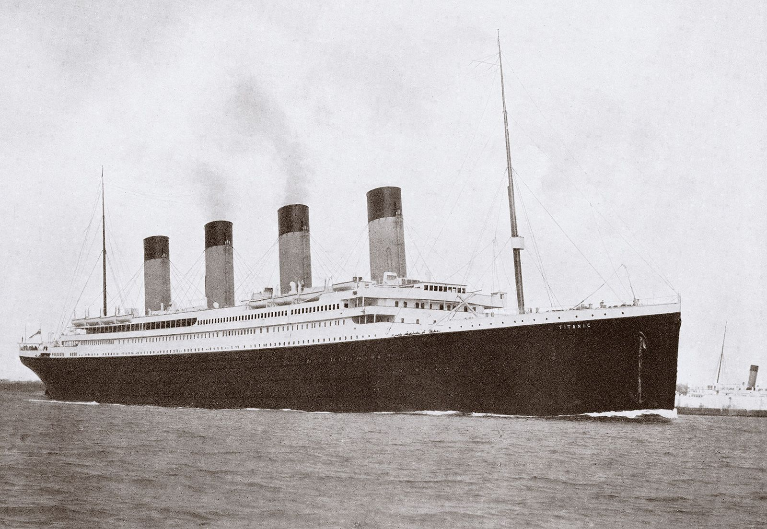
Titanic
Finding insights from the data
Data Understanding & Preparation
Assess the quality of the data
Create a plan to address (through data engineering)
Potentially incorrect data
Missing data
Collection of additional data that might be useful
Decision-making
Given the data you have and the understanding of who is more likely to survive, what else could be done to improve the survival rate?
Obviously, other than “adding more lifeboats”

Slide 33
Team Project
Team set up and project brainstorming

Slide 34
Team Project
First, create a group
4-5 people
Select a cool team name
Enroll yourself in the group on Brightspace
Brainstorm
What problems are you trying to solve?
What questions are you trying to answer?
What kind of data will you need?
Do this by
Sept. 7th

